Slide 1
Cumulative effects of development and climate change on the PCH
Progress report to the PCMB, October 23, 2012
by Don Russell

Slide 2
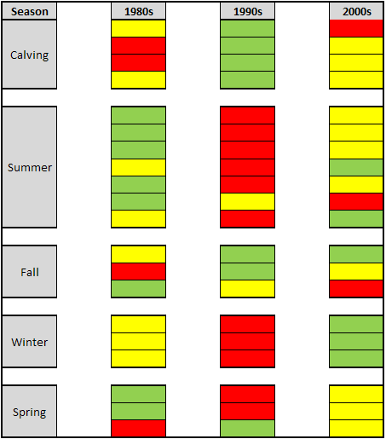
Climate analysis
1990s best conditions during calving
1990s worst conditions in summer
1980s best conditions in summer
Conditions mixed in fall
1990s worst conditions in winter
2000s best conditions in winter
1990s worst conditions in spring

Slide 3
Winter RSF analysis
Avoidance of Dempster
Not related to snow
Stronger between 1985-1998 than 1999-2010
Appear strong avoidance of communities
May be related to location of communities at periphery of range and/or avoidance in relation to human activity
Weak avoidance of seismic lines and winter road
Not related to snow
Stronger between 1985-1998 than 1999-2010
NEED TO TRANSLATE RESULTS INTO DEVELOPMENT SCENARIOS

Slide 4
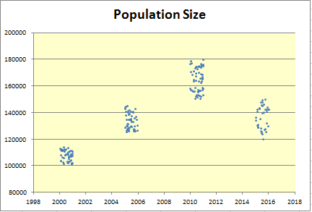
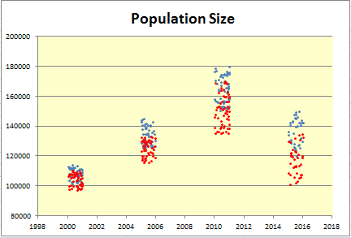
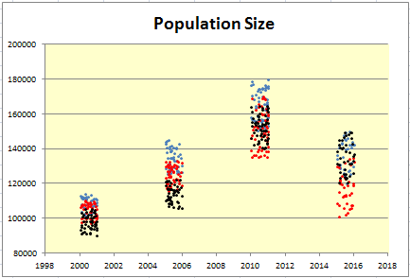
Modeling Cumulative effects
Climate
change
Development
Body size
Link to vital rates (birth, death, etc)
Climate variability
Energy -Protein model
Vegetation
Development
Development
Population Density
Normal conditions
Normal conditions
Population model
Harvest policy
Harvest policy
-aggressive during increase
-restricted in decline
Climate change, development
Climate change, development

Slide 5
Input data – what we need to run the model
DONE
TO DO
Over 1000 caribou sampled
Validation data
Fat and Protein estimates
Body size
X
CARMA Climate database
33 years (1979-2011)
Analysis complete
Need to develop input datasets to reflect role of climate in population trends
Climate variability
Vegetation
CCRS map revised by S. Francis
X
Develop input datasets to reflect role of density in changes in body condition
Population Density
Based on population estimates

Slide 6
Scenarios – running E-P model, developing scenarios
DONE
TO DO
Energy -Protein model
Model revised to include protein
Scenario Builder complete
X
Historical climate analysis complete
Develop, run, evaluate future climate scenarios
Climate change
Development
(Dempster)
Human footprint map
RSF model on Dempster
Develop, run, evaluate future climate scenarios
Major update – especially recent use of 1002 (3rd Summer Ecology report?)
Development
(1002)
Old analysis of 1002 development – “Sustain”
Development
(other)
How to handle one-off development projects
X

Slide 7
Output – factors to link condition to vital rates
DONE
TO DO
Link to vital rates (birth, death, etc)
Need thorough review of linkages
Develop easy way to output key factors
Model tracks all factors

Slide 8
Caribou “estimator”
TO DO
DONE
Develop linkage to E-P model output
Develop easy way to output key factors
Do we want to carve out role of predator
Population model
Model now includes variability and risk – (version 1)
Currently focus of “estimator”
Develop, run, evaluate population level policies (e.g. predator control)
Harvest policy
Model now includes variability and risk – (version 1)
Develop, run, evaluate other actions (e.g. 1002 mitigations)
Other management actions

Slide 9
CARMA 2012
Gathering in Vancouver December 4-6, 2012
Theme “CARMA moving from Knowledge to Action”
Nomination for Arctic Inspiration Prize
Knowledge to Action Plan focussed on:
Managing and monitoring through abundance
Assessing Cumulative Effects
Caribou health monitoring plan
New Website www.caff.is/carma

